Slide 1

GirlCode 2019
Javascript Workshop
Sponsored by Entelect Software
Image credit: Duart Breedt

Slide 2
Javascript. js

Slide 3

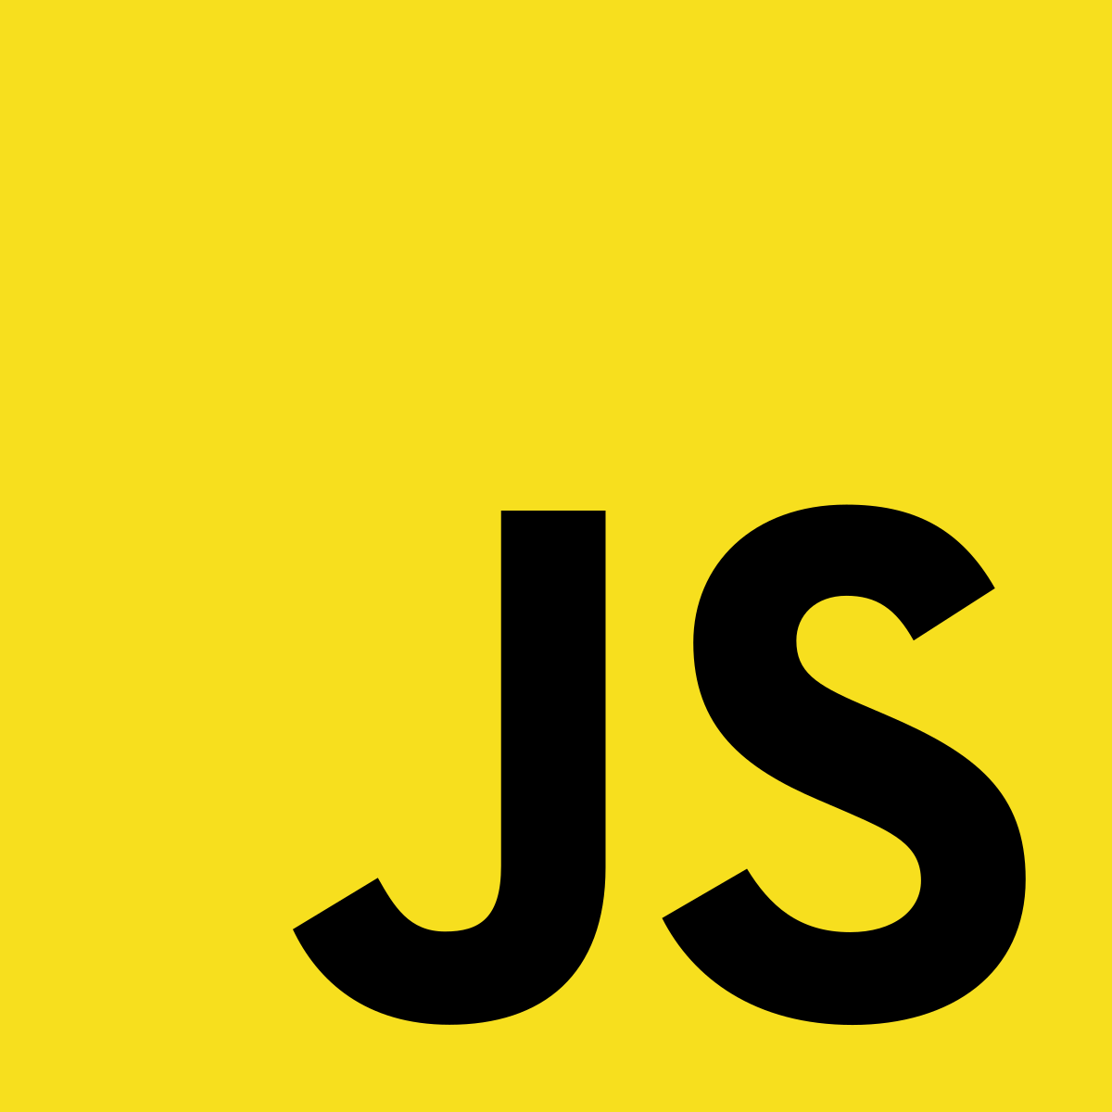
JavaScript
What is a JavaScript?
Definition An object-oriented computer programming language commonly used to create interactive effects within web browsers.
Interpreted Javascript is interpreted by web browsers and some other runtimes, which means that it does not need to be compiled! Saving you time and complicated setups
Widely Used The vast majority of websites on the internet use JavaScript for one reason or another
JavaScript !== JAVA JavaScript has nothing to do with Java
Notes:
Visual Studio Code IDE
Web Browser of choice - Web tools
.HTML and .JS files

Slide 4
TOOLS. js

Slide 5
Tools for this workshop
Tooling to make our experience easier
Visual Studio Code A modern Integrated Development Environment (IDE) - Where we’re going to write our code
Web Browser of your choice Chrome, Firefox, Edge, Internet explorer
.HTML and .JS Files You can use .HTML files from an earlier workshop or create some new ones - It’s up to you!
Notes:
Visual Studio Code IDE
Web Browser of choice - Web tools
.HTML and .JS files

Slide 6
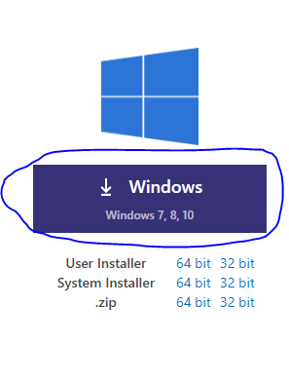

IDE Setup
code.visualstudio.com/download
tiny.cc/9dmm6y
Open extensions menu
Click on the overflow menu
Install from VSIX
Select the downloaded file
If you don’t have internet access, please let us know!

Slide 7

Slides
http://tiny.cc/fp7v6y
If you don’t have internet access, please let us know!

Slide 8
Test
https://forms.gle/tJ4YFqDieQKfSnLL6
If you don’t have internet access, please let us know!

Slide 9
Developer Tools
Simply press F12 on your keyboard and navigate over to your console section.
Please call one of us over if you need help!
Notes:
This is a basic function. You can see the function name (showMessage), empty parameters in the brackets (no inputs), a body but without any return or outputs.
You can see how I run or invoke the function with showMessage(). The brackets are the important part of the invocation, without them the function is just a fancy variable.
Please write this introductory function. “Hello World” is one of the first functions all programmers learn to write, so welcome to the club. :)

Slide 10
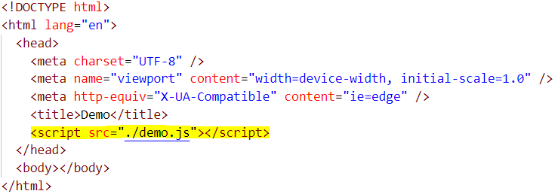
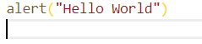
.HTML and .js files
Please create a .html file and a .js file in the same folder per section
demo.html
demo.js
Notes:
This is a basic function. You can see the function name (showMessage), empty parameters in the brackets (no inputs), a body but without any return or outputs.
You can see how I run or invoke the function with showMessage(). The brackets are the important part of the invocation, without them the function is just a fancy variable.
Please write this introductory function. “Hello World” is one of the first functions all programmers learn to write, so welcome to the club. :)

Slide 11
Variables. js

Slide 12
Variables
Storage of information Store values in a variable
Passing around of information Pass values into functions
Better understanding of problems Used to give a better definition to values to make sure they help explain a story of the problems

Slide 13
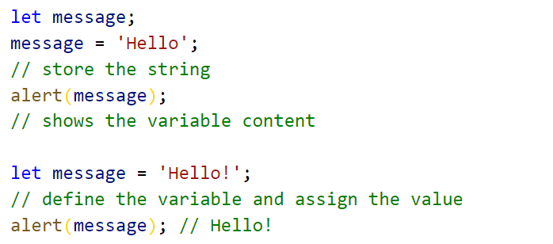
Variable Exercise
How to declare variables
Notes:
A variable is named storage for data
To create a variable we use the let keyword
We assign values to a variable with the assignment operator
Now we can use variable to access the value
Variables can be set and assigned on single line

Slide 14
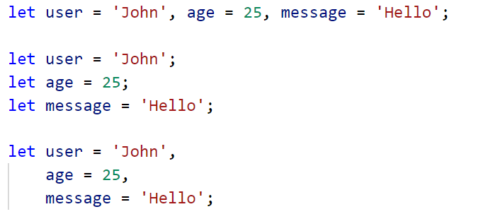
Variable Exercise
How to declare variables continued
Notes:
Can be declared on single and multiple lines

Slide 15
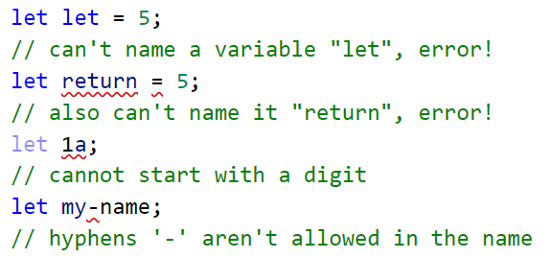
Variable Exercise
Incorrect variable declaration
Notes:
Don't use reserved names

Slide 16
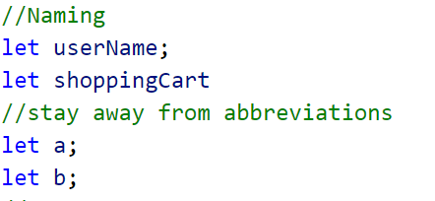
Variable Exercise
Naming continued
Notes:
Make sure the names are readable
Let them tell a story
Camel case

Slide 17
Advanced Variables

Slide 18
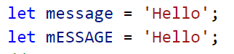
Variable Exercise
Variables are case sensitive
Notes:
Javascript is case sensitive
So make sure you use the same case

Slide 19
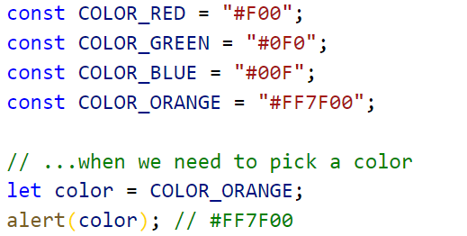
Variable Exercise
Constants
Notes:
Use constants to alias values for a better understanding
Can be named using uppercases and underscores
A constant means a variable can not change
If you try to change it it will error out

Slide 20
Code Comments js

Slide 21
Code Comments
Bad comments Used for explaining what is going on in code
Good comments Used to tell a story about the problem. That is very specific to the problems domain. Can also be used to document use of functions.
Auto documenting comments Used for documenting functions so some IDEs can read these and give you code smells.
Notes:
Explain about domain
How the components and function fit together
Function usage.
Domain solutions, especially when not immediately obvious.
Avoid comments:
That tell “how code works” and “what it does”.
Put them only if it’s impossible to make the code so simple and self-descriptive that it doesn’t require those.

Slide 22
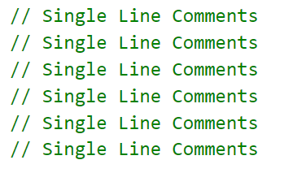
Code Comments Exercise
Single line comments
Notes:
How you comment single lines

Slide 23
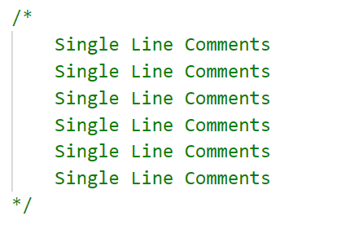
Code Comments Exercise
Multiple line comments
Notes:
How you comment multiple lines

Slide 24
Operators. js

Slide 25
Operators
What is an Operator?
Operand Is what operators are applied to
Unary If it has a single operand
Binary If it has two operands
Other Standard Operators + - / *
Notes:
Name
Parameters (Inputs)
Body (Processes)
Return (Outputs)

Slide 26
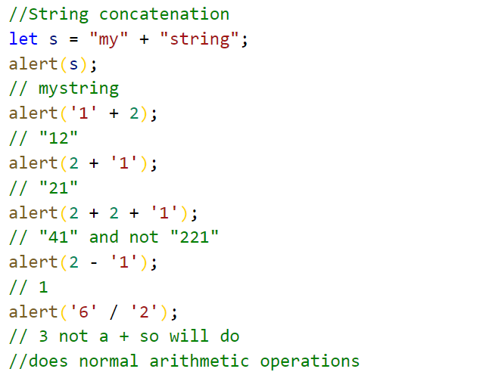
Operator Exercise
String concatenation binary +
Notes:
usually used for addition
it will merges (concatenates) strings
if one of the operands is a string, the other one is converted to a string too.
operations run from left to right. If there are two numbers followed by a string, the numbers will be added before being converted to a string:
String concatenation and conversion is a special feature of the binary plus +. Other arithmetic operators work only with numbers and always convert their operands to numbers.

Slide 27
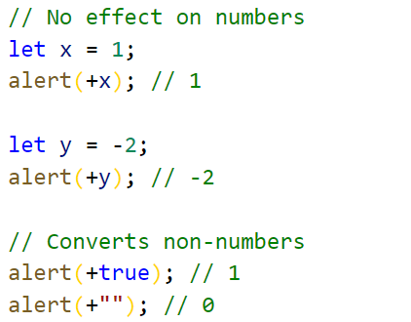
Numeric conversion, unary +
Numeric conversion, unary +
Notes:
The operator applied to a single operand
Has no effect on numbers.
will convert values that are not number to numbers
This is common because with javascript most values when fetched from HTML will be strings

Slide 28
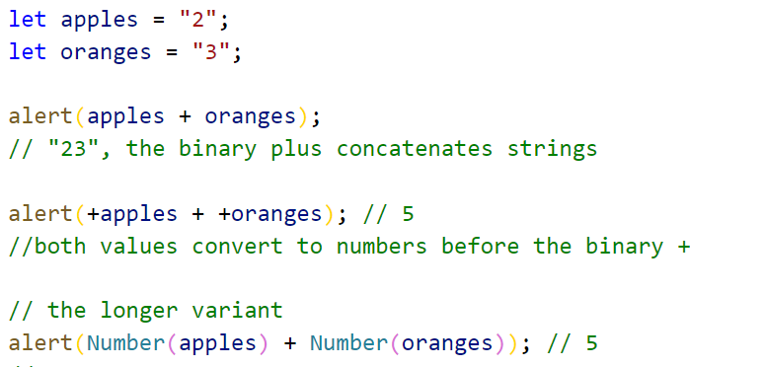
Numeric conversion, unary +
Numeric conversion, unary + continues
Notes:
The same values with variables
Also a numbers(.....) example

Slide 29
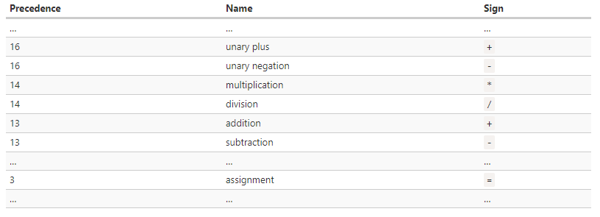
Operator Exercise
Operator precedence
Notes:
This happens when there is more than one operator
We all remember bodmas from school
Parentheses override any precedence
Every operator has a corresponding precedence number.

Slide 30
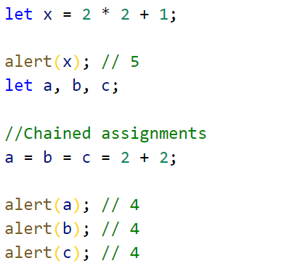
Operator Exercise
Assignment =
Notes:
= is also an operator
Has the lowest priority of 3
this way calculations are done first
Chained assignments will evaluate from right to left

Slide 31
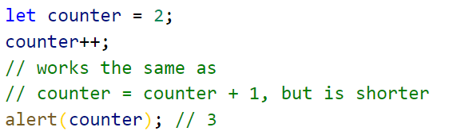
Operator Exercise
Increment ++
Notes:
Increases a value by 1
Used in loops

Slide 32
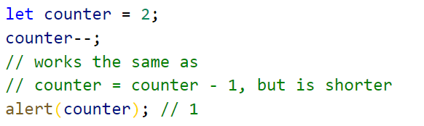
Operator Exercise
Decrement --
Notes:
Decreases a value by 1
Used in loops
Both can be placed be before or after an operand
But do

Slide 33
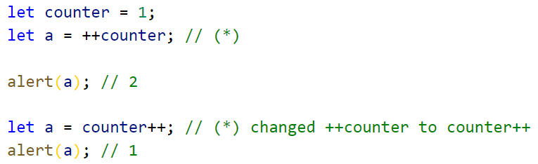
Operator Exercise
Increment and decrement Placement
Notes:
Both can be placed be before or after an operand
But do not do the same thing
If the result of is not assigned or used to an operand there is no difference
If you want the operand incremented use the the pre set ++operand
If you want the original value then increment use the post operand++
The precedence is higher when used with other operators but should not be used as it can easily be missed

Slide 34
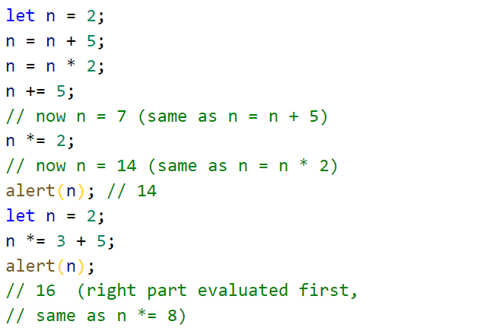
Operator Exercise
Modify In Place
Notes:
Used on an operand / variable to store in the same operand .variable
Can be used with long and short version check above
They will have the same precedence as normal assignment operators

Slide 35
Advanced Operators. js

Slide 36
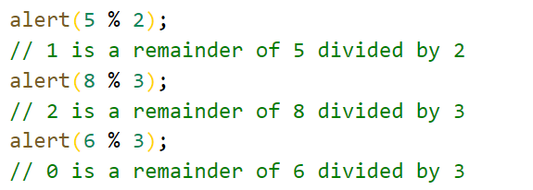
Operator Exercise
Remainder %
Notes:
Has nothing to do with the percentage sign
This is the will give you a remainder of what is left after dividing it by the second operand.

Slide 37
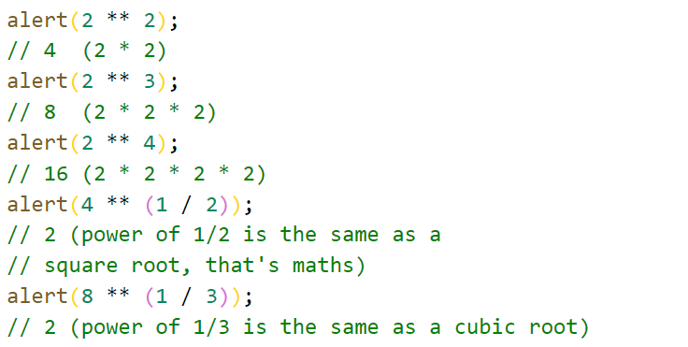
Operator Exercise
Exponentiation **
Notes:
recent addition to the language
a ** b is a multiplied by itself b times.
Has some cool tricks

Slide 38
Comparisons. js

Slide 39
Comparisons
What is a Comparison
Compares two values to see if they follow some rule Is 1 + 1 equal to two? Yes.
Comparison Operators Similar to before in operators, now we can tell if two things are equal
Used to test for true or false They help us make decisions and guide our code

Slide 40
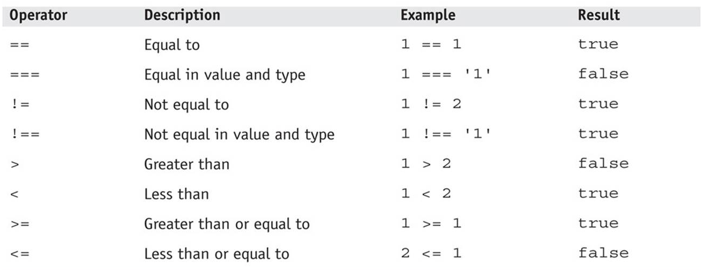
Comparisons
Some Basics
Notes:
In code, we often need to compare two things together in some way. Previously, with julian, you saw that one equals sign, `=`, takes the value on the right hand side, and stores it into the name on the left hand side, called a variable.
Now if I want to compare two things together, to see if they are equal, I can use two, `==`, or three, `===`, equals signs.
These are called *Comparison operators*
When I do this, it will return us a `boolean` value. This just means a yes or no, but in code we talk about "true" or "false".
“Console.log” is a *function*, which grant will cover later in more detail. For now, all we need to know is that it will allow us to see the text appear in our console in the browser.

Slide 41
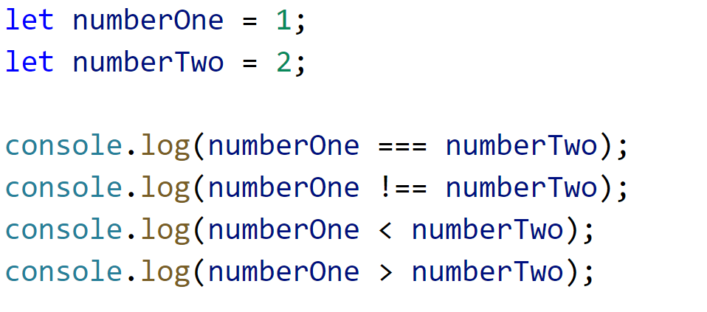
Comparisons with type
Notes:
Another Example:
if ((1 + 1) === 2) {
console.log("Math works!");
}

Slide 42
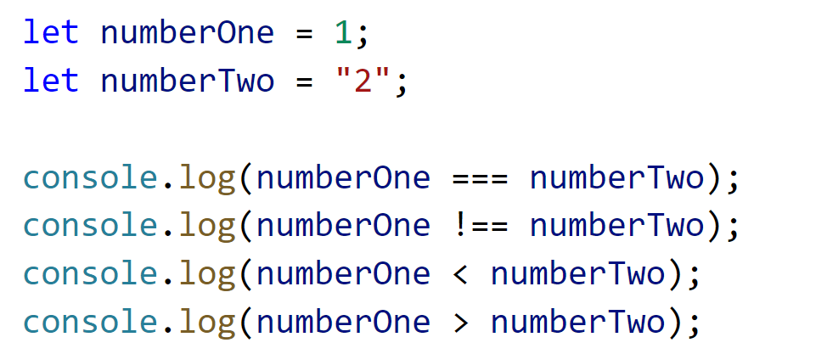
Comparisons with type...
Notes:
Another Example:
if ((1 + 1) === 2) {
console.log("Math works!");
}

Slide 43
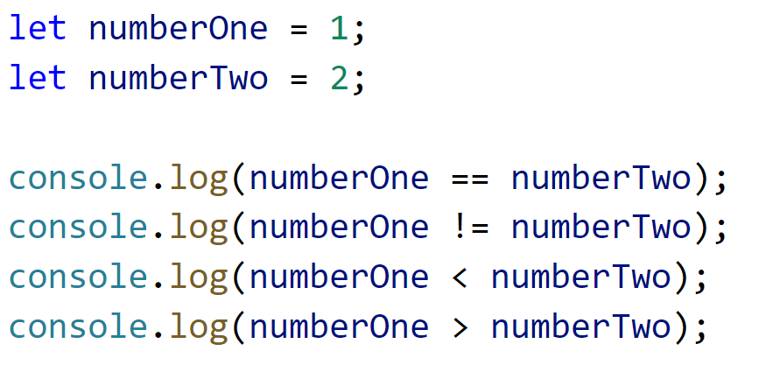
Comparisons without type
Notes:
Another Example:
if ((1 + 1) === 2) {
console.log("Math works!");
}

Slide 44
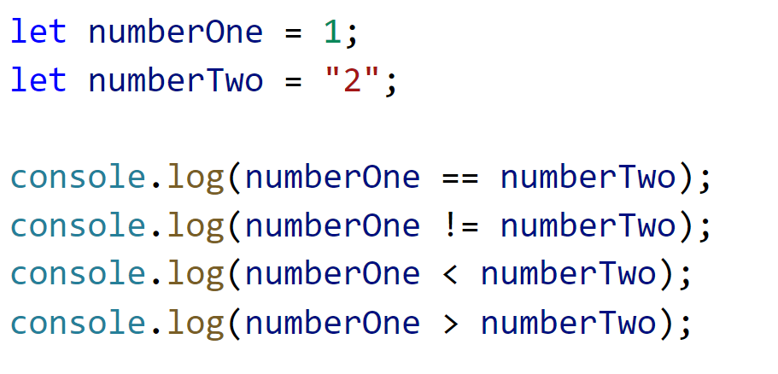
Comparisons without type...
Notes:
Another Example:
if ((1 + 1) === 2) {
console.log("Math works!");
}

Slide 45
Conditionals. js

Slide 46
Conditionals
What is an Conditional?
Decision Are what conditionals allow us to make
Control Is what we use them for
Predicate The thing we use to make our choice, our “reason”
Code Block The thing we do if we decided “yes”
Notes:
"Conditonals" are simply just decisions. When the code gets to a certain point, and needs to decide between doing two different things.
Real world examples: If I am given work during the week, I will do my work. If I am given work during the weekend, I will not do my work until monday.
In Code, we use conditionals to allow our code to make decisions based on things that happen.

Slide 47
Conditionals
What Conditionals do we have?
If The simplest type, if yes, do this.
If Else Allows us to do another option, if we decide no.
If Else, If What if we only want to the other option, if something else is also a “yes”?
Switch Let’s check our option against multiple results.
Notes:
"Conditonals" are simply just decisions. When the code gets to a certain point, and needs to decide between doing two different things.
Real world examples: If I am given work during the week, I will do my work. If I am given work during the weekend, I will not do my work until monday.
In Code, we use conditionals to allow our code to make decisions based on things that happen.

Slide 48
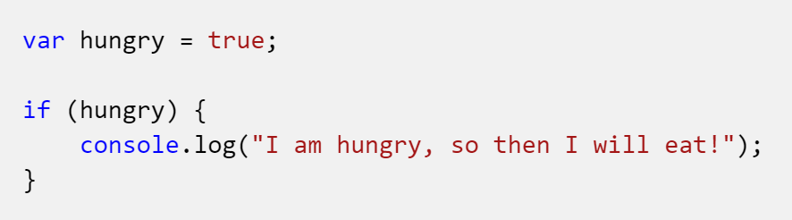
If Statement
If I am hungry, then I eat.
Notes:
The 'If' statement always follows the simple structure of "if this thing is true, then do that thing".
We start by writing the word 'if', followed by opening brackets. Then, we put anything that will equal true, inside the brackets.
“Console.log” is a *function*, which grant will cover later in more detail. For now, all we need to know is that it will allow us to see the text appear in our console in the browser.

Slide 49
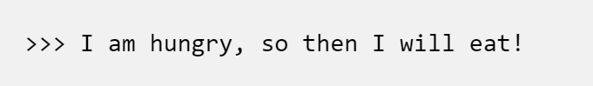
If Result
Notes:
Another Example:
if ((1 + 1) === 2) {
console.log("Math works!");
}

Slide 50
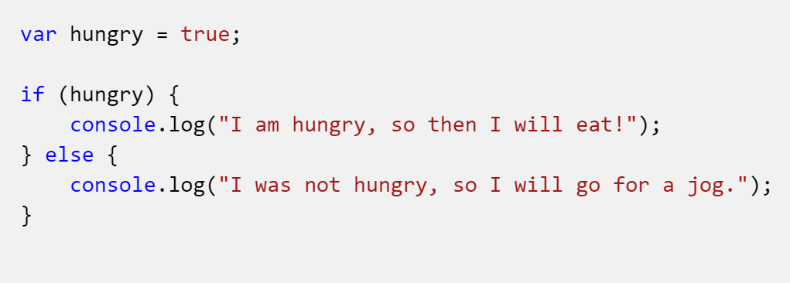
If Else Statement
What if, I'm hungry, then I eat, but if not, then I go for a jog?
Notes:
What happens when there isn't one choice in the situation? What if, I'm hungry, then I eat, but if not, then I go for a jog?
Well, JavaScript gives us the **else** statement to use for these situations.
It must always be used after an if statement, and will happen *whenever the if statement doesn't*

Slide 51
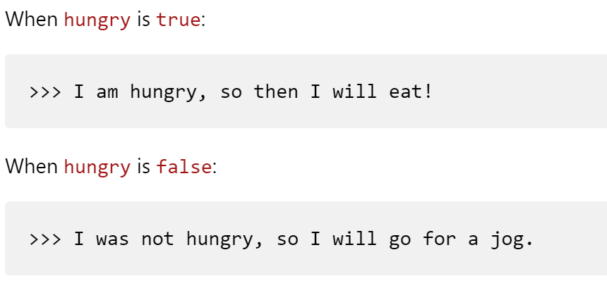
If Else Result
String concatenation binary +

Slide 52
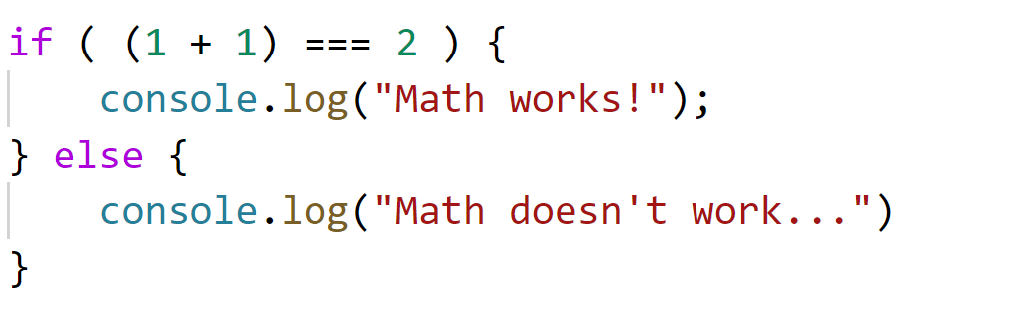
If Else Continued
Try this:

Slide 53
Advanced Conditionals. js

Slide 54
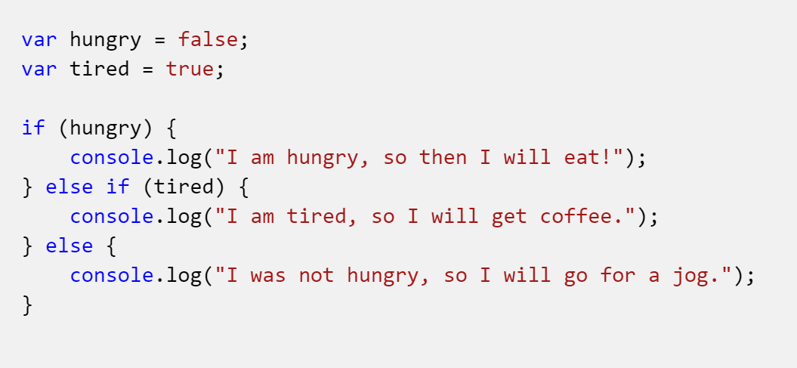
If Else, If Statement
We can put the If/else together with more if statements.
Notes:
Else If
Else is a nice way to do a "default" action, that is, if there is something I specifically want to do when something else is true.
However, What if I want to check multiple different things at once?
Well, we can put the If/else together with more if statements.

Slide 55
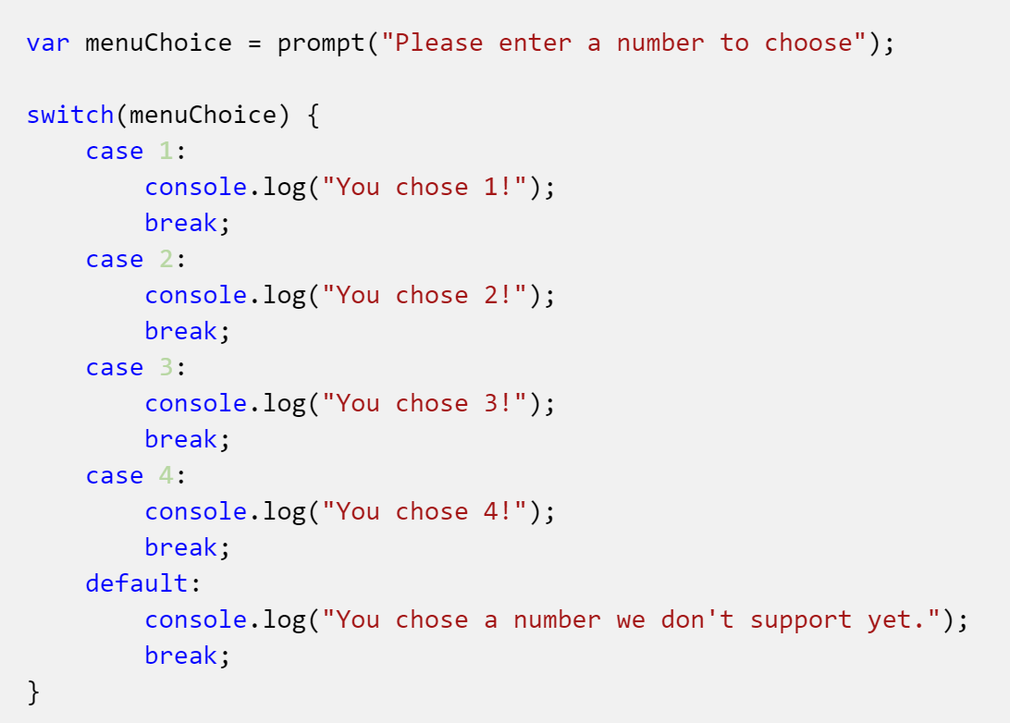
Switch Statement
We use a switch case when we want multiple of those options. The simplest use is a menu.
Notes:
Alright, now we have an If statement, an else statement, and another else if statement. Now we have a switch case. How is that different?
In an If/else statement, we have two choices: Either it is the thing, or we do something else.
We use a switch case when we want multiple of those options. The simplest use is a menu.
We start by writing the word "switch" followed by what we are planning to use to "match" against.
We then define all our different cases that we support: What are the things we are looking for to do something specific?
Then, we add a default, so that we can tell our users when they've chosen something we aren't able to use.

Slide 56
Blocks. js

Slide 57
Blocks
What is a Block or Code Block?
Separate A code block separates a portion of code into a reusable piece
Acts as One Line When the block is used elsewhere
{ } Curly braces mark the start and end of the block

Slide 58
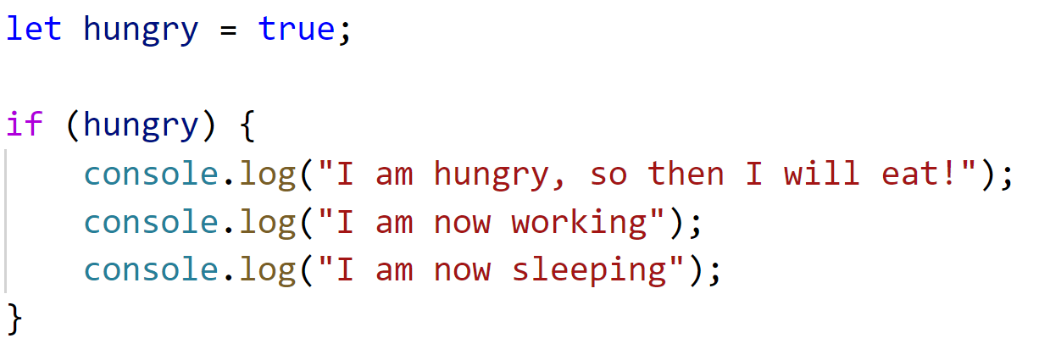
Block Exercise
Notes:
Remember when we said if we are hungry, then we will eat? We can expand on the then we will eat, by adding more things to do, like work and sleep: Blocks are the reason we can do this. We can expand one line into many things by wrapping it in a code block.
How? Simple: Use {} around as many lines of code as you like. If you look again at our if statements, you'll see that this isn't anything new.

Slide 59
Objects. js

Slide 60
Objects
What is an Object?
An object is a self-contained item in code Like an object in real Life
It contains Properties Data that describes it
And Methods Actions that can be performed
Notes:
Tissue Box Example.

Slide 61
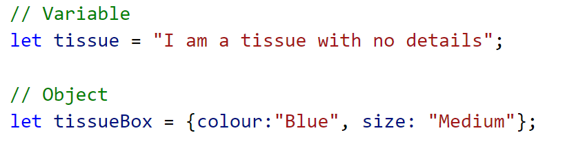
Object Exercise
Notes:
Take them through declaration and instantiation

Slide 62
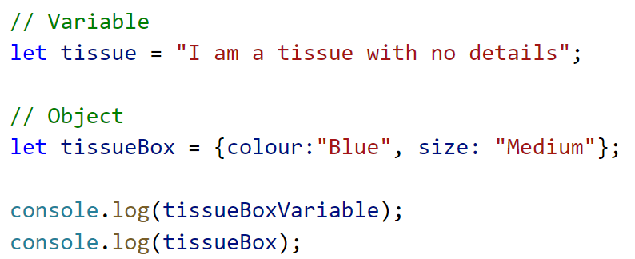
Object Exercise...
Notes:
Printing the difference between the two

Slide 63
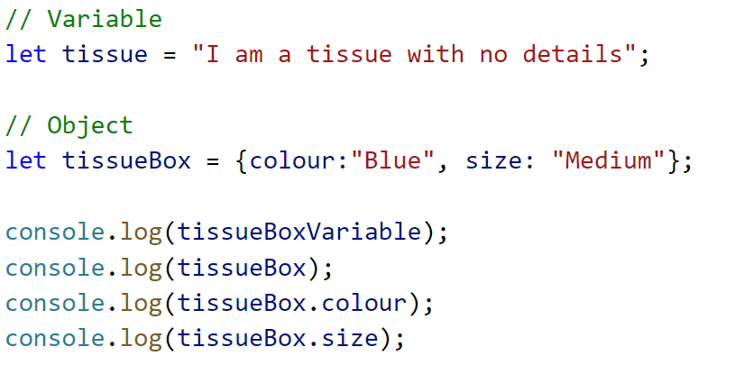
Object Exercise
Notes:
Property accessoors

Slide 64
Advanced Objects. js

Slide 65
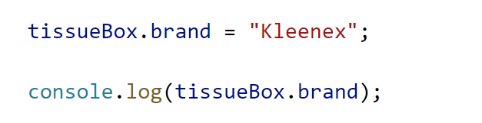
Object Exercise
Notes:
Adding a new property to the object

Slide 66
FUNCTIONS. js

Slide 67
Functions
What is a function?
Name A function should always have a name
Parameters (Inputs) A function can have parameters
Body (Process) A function body is where the magic of a function happens
Return (Output) A function can return one value
Notes:
Name
Parameters (Inputs)
Body (Processes)
Return (Outputs)

Slide 68
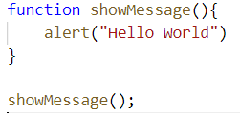
Functions Exercise
Let’s create an introductory function
Notes:
This is a basic function. You can see the function name (showMessage), empty parameters in the brackets (no inputs), a body but without any return or outputs.
You can see how I run or invoke the function with showMessage(). The brackets are the important part of the invocation, without them the function is just a fancy variable.
Please write this introductory function. “Hello World” is one of the first functions all programmers learn to write, so welcome to the club. :)

Slide 69
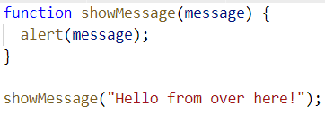
Functions Exercise
Let’s use a parameter (input)
Notes:
This function has an input parameter called message. This means that I have to supply a message when I invoke the function. Please write this code and supply your own message.

Slide 70
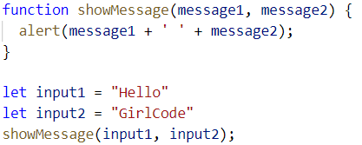
Functions Exercise
Let’s use two parameters (inputs)
Notes:
This function is taking two input parameters. That means that I have to supply both parameters in order to get this function to run! Please write this function, with the function body of your choice. :)

Slide 71
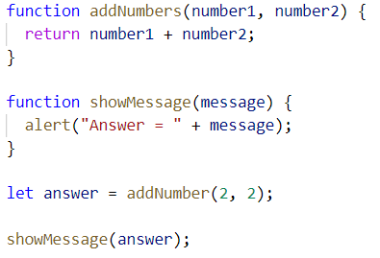
Functions Exercise
Let’s give something back
Notes:
The addNumbers function returns the result of the addition of number1 and number2. We can see the return keyword highlighted in the code. No code will execute in the function body after the return statement. In the result line, you can see that we are assigning the result of the function to the result variable.

Slide 72
ADVANCED_FUNCTIONS. js

Slide 73
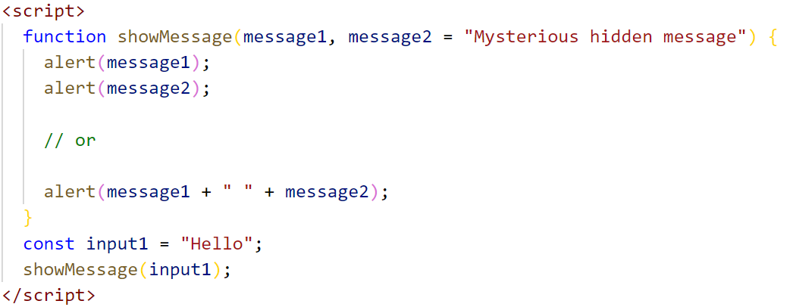
Functions Exercise
Let’s be a little cheeky - default a parameter
Notes:
This function is special in that it has one of it’s input parameters set to a default value. This means that we don’t necessarily need to provide this second parameter. Write this code and see what happens. Then try writing this code, supplying a second input parameter of your choice.

Slide 74
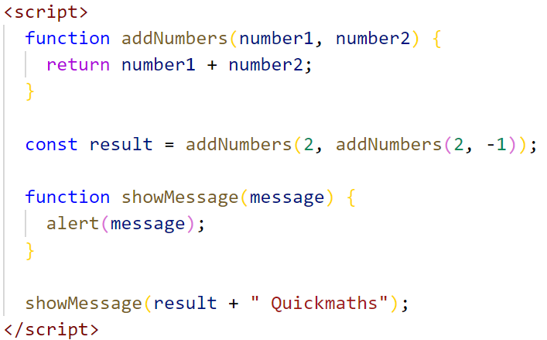
Functions Exercise
Let’s kick it up a notch
Notes:
We can get fancy and use the output of one function as the input to another function too. What do you think is going to be shown to you before you run this code? Please write this out, write your own values, maybe nest another function deeper! Call us if you need a hand.

Slide 75
ARRAYS. js

Slide 76
Arrays
What is an Array?
Name An array is a special type of variable and variables always have names
Content An array can have content that we can access via an index
Length An array has a length property, which signifies the number of items in the array
Array Functions An array has a number of functions baked in that allow you to read and write data to the array
Notes:
Name
Content
Length
Associated Array Functions

Slide 77
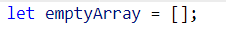
Array Exercise
Let’s create an empty array
Notes:
You can declare an array in two ways, both of these are functionally equivalent, you end up with an empty array assigned to emptyArray. The first example is far more often used.

Slide 78
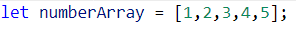
Array Exercise
Let’s create an array with some items
Notes:
This is an example of initialising an array with values

Slide 79
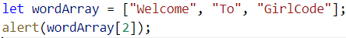
Array Exercise
Let’s get a value out of an array
[0] [1] [2]
Notes:
Arrays can contain all sorts of data. In this example you can see that we have an array of strings. The brackets in the alert tell us that we’re going to pull a value (one of the strings) out of the array at position 2. It’s important to note that this will be the third item in the array as we read it, because with Arrays we always start counting from 0. Type this code out. What do you think is going to be alerted? It’s important to remember that in Javascript, like in most good programming languages, arrays start at 0.

Slide 80
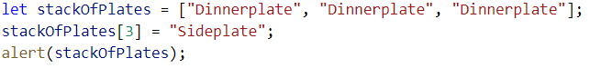
Array Exercise
Let’s add a another plate
[0] [1] [2]
Notes:
You can add an element (in this case a plate) to an array by assigning the value to an open position on the top of the plate stack. But what if I put a plate in position 5? Plates can’t hover in mid air! This leaves you with “Holes” in your array.

Slide 81


Array Exercise
Let’s add a plate to the top of the stack
Notes:
I can push another plate onto the top of the stack without having to worry about how tall the stack is, or how many plates there are in my stack. I can’t end up with empty plate holes in my array if I use this method.

Slide 82


Array Exercise
Let’s get a plate from the top of the stack
Notes:
I can also pop a plate off the top of my stack. This removes the plate from the stack, so the stack is shorter once I’m done.

Slide 83
ADVANCED_ARRAYS. js

Slide 84

Array Exercise
Not the word we were expecting?
Notes:
If you don’t know the index of the element you want to use, you can count from zero in the array, or use can use the indexOf() function of the array data type. What number did you get back in your alert?

Slide 85
Array Exercise
How long is our array again?
Notes:
I can use the length array property to see the length of my array. This will be useful later on. Please notice that this is a property and not a function.

Slide 86
LOOPS. js

Slide 87
Loops
What is a Loop?
Counter The counter helps us control how many times a loop runs
Condition Is a statement that returns true or false, controlling the loop
Step A function that modifies the counter of the loop
Block Code that will be executed for each iteration (run) of the loop
Notes:
A loop is a way to repeat code without having to type it out again. So if we need to do something over and over again, we’d use a loop of some kind. Computers are really good at this. This let’s them to things that would be too complex for people to do!
Counter
Condition
Step
Body

Slide 88

Loop Exercise
Why do we need loops?
If we wanted to add 3 and only 3 plates to a stack of plates, we’d have something that looks like this:
Notes:
If we wanted to add 3 and only 3 “Welcome to GirlCode” strings to an array, we’d have something that looks like this. We’d need to check how many plates we’d added to the stack, What if we wanted to add more plates? What if we wanted to add different plates? We’d have to write and change a lot of code. This is really messy.

Slide 89

Loop Exercise
Let’s create an introductory loop
Counter
Condition
Block
Step
Notes:
So Let’s create a basic loop. This loop produces exactly the same output as the previous slide.
We know loops always have a counter, a condition, a block and a step that affects the state.
You can see that numberOfPlates represents our counter, our condition is that numberOfPlates is less than three, Our block contains the code we want to repeat. The step affects the numberOfPlates and makes sure that we don’t keep looping forever, which would make us end up with a lot of plates.
Add an alert before loop count step to see the counters, like we did in the previous example Try make the condition add WAAAAY more plates.

Slide 90
ADVANCED_LOOPS. js

Slide 91

Loop Exercise
Do While loops
Notes:
A do while loop runs a minimum of one time. This can be useful for certain situations, especially if a loop needs to define whether it should run again. This loop will run once and only once due to our conditional.

Slide 92

Loop Exercise
For loops
Initial State
Condition
Step
Body
Notes:
This is a for loop. We set the initial state in the function body of the for loop, we also set the condition, after a semi colon. Then we also specify an iterator. LoopCount ++ === loopCount = loopCount+1

Slide 93

Loop Exercise
Looping through an array
Notes:
This for loop is using the wordArray’s length as the upper bound of it’s conditional. This is to make sure that your loop will never read outside of the wordArray’s values

Slide 94

Loop Exercise
Some more advanced Javascript loops
Notes:
This is called a for in loop, the condition set to be that the loopCount is less than the length of the wordArray, the initial state is set to 0, or the first element of the wordArray. The step is also automated here.

Slide 95

Loop Exercise
Using array functions for a more advanced loop
Notes:
This loop uses one of the functions on the array data type. This iterates through the array, indexes the value into the variable we have called word. It also allows us to read the index it’s using, we’ve assigned this index to loopCount.

Slide 96
References
https://javascript.info/function-basics
https://javascript.info/array
https://quizlet.com/236992008/mjs-array-methods-flash-cards/
https://www.i-programmer.info/babbages-bag/263-stacks.html
https://javascript.info/while-for#tasks

Slide 97
RESOURCE SLIDES AFTER THIS POINT

Slide 98
Links
Comparison Operators
https://apprize.info/javascript/20lessons/4.html
https://www.w3schools.com/js/js_comparisons.asp

Slide 99
1. Intro
Choose one approach to grab the audience’s attention right from the start: unexpected, emotional, or simple.
Unexpected Highlight what’s new, unusual, or surprising.
Emotional Give people a reason to care.
Simple Provide a simple unifying message for what is to come

Slide 100
How many languages do you need to know to communicate with the rest of the world?
Tip
In this example, we’re leading off with something unexpected.
While the audience is trying to come up with a number, we’ll surprise them with the next slide.

Slide 101
Just one! Your own.
(With a little help from your smart phone)
Tip
Remember. If something sounds like common sense, people will ignore it.
Highlight what is unexpected about your topic.

Slide 102

The Google Translate app can repeat anything you say in up to NINETY LANGUAGES from German and Japanese to Czech and Zulu
Tip
Don’t wait till the end of the presentation to give the bottom line.
Reveal your product or idea (in this case a translation app) up front.

Slide 103
2. Examples
By the end of this section, your audience should be able to visualize:
What What is the pain you cure with your solution?
Who Show them a specific person who would benefit from your solution.

Slide 104

Meet Alberto.
He recently moved from Spain to a small town in Northern Ireland.
He loved soccer, but feared he had no way to talk to a coach or teammates.
Tip
Tell the audience about the problem through a story, ideally a person.

Slide 105

Meet Marcos.
He recently opened a camera shop near the Louvre in Paris.
Visitors to his store, mostly tourists, speak many different languages making anything beyond a simple transaction a challenge.
Tip
If one example isn’t sufficient to help people understand the breadth of your idea, pick a couple of examples.
Story for illustration purposes only

Slide 106

A translation barrier left Alberto feeling lonely and hurt Marco’s business.
Tip
Ideally, speak of people in very different situations, but where each could benefit from your solution.

Slide 107

Then, Marcos discovered Google Translate
He has his visiting customers speak their camera issues into the app.
He’s able to give them a friendly, personalized experience by understanding exactly what they need.

Slide 108

A simple gesture
Coaches Gary and Glen knew no Spanish.
They used Google Translate to invite Alberto to join in... “Do you want to play?”... “Can you defend the left side?”
Tip
Show how your solution helps the person in the story reach his or her goals.

Slide 109

From outsider to star
Alberto scored 30 goals in 21 games. He is now being scouted by several professional clubs in the Premier League. And he’s a favorite of the other boys on the team.
See a short video on Alberto’s story
Tip
Stories become more credible when they use concrete details such as the specific complex moves Alberto learned through Translate and his 30 goals in 21 games performance stats.

Slide 110
3. Examples
People need to understand how rare or frequent your examples are.
Pick 1 or 2 statistics and make them as concrete as possible. Stats are generally not sticky, but here are a few tactics:
Relate Deliver data within the context of a story you’ve already told
Compare Make big numbers digestible by putting them in the context of something familiar

Slide 111
It’s no surprise Marcos uses Google Translate in his shop regularly.
There are 23 officially recognized languages in the EU.
Tip
Don’t let data stand alone. Always relate it back to a story you’ve already told, in this case, Marco’s shop.
Source: theguardian.com

Slide 112


More than 50 million Americans travelled abroad in 2015
THAT’S MORE THAN THE POPULATION OF
CALIFORNIA AND TEXAS COMBINED
Tip
When a number is too large or too small to easily comprehend, clarify it with a comparison to something familiar.
Source: travel.trade.gov

Slide 113
Milestones
October 2014
October 2015
August 2015
November 2015
Translate web pages with Chrome extension
Translate text within an app
2014 |  |  |  | 2015
Translate conversations through your Android watch
Translate written text from English or German to Arabic with the click of a camera

Slide 114
What people are saying
With this app, I’m confident to plan a trip to rural Vietnam
Wendy Writer, CA
Visual translation feels like magic
Ronny Reader, NYC
Translate has officially inspired me to learn French
Abby Author, NYC
Quotes for illustration purposes only

Slide 115

Know a 2nd language? Make Google Translate even better by joining the community.
Tip
Inspire your audience to act on the information they just learned.
Depending on your idea, this can be anything from downloading an app to joining an organization.

